Slide 1
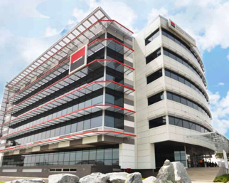
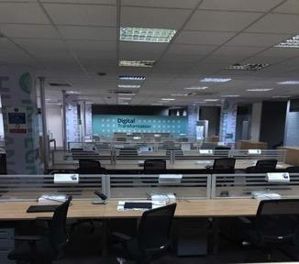
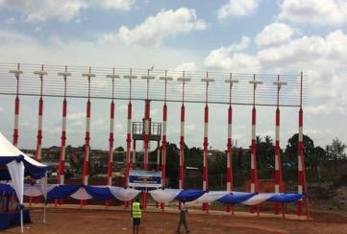
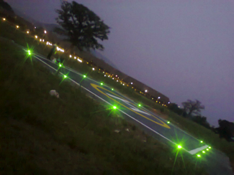
Company Profile
C O N S I L I U M L I M I T E D
P . O. BOX C T 7631 C A N T O N M E N T S A C C R A
TEL: 00233 (0) 24 462 2668 / (0)233 000046

Slide 2
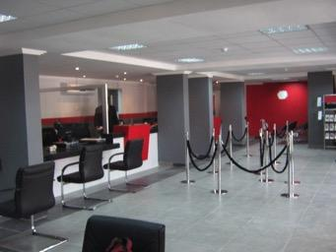
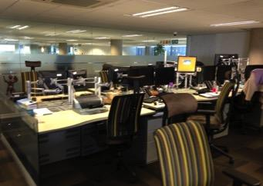
Welcome to Consilium
Consilium Limited is a building and Civil Engineering Project Management firm which is committed to excellence and to developing efficient, functional, beautiful and yet cost effective projects in Ghana. Consilium is registered as a limited liability company in Ghana.
Our firm has a strong backbone formed by an enthusiastic team of young men and women who are well respected for their academic excellence, sought after for commercial advice and dedicated to developing the various buildings and structures to which they have been committed. This wealth of expertise and experience is structured so as to enable it to play a balanced, multi disciplined role which is fully supportive of and entirely complimentary to the projects carried out by the company.
Consilium is committed to delivering quality projects to its customers throughout the world - our commitment to quality commences upon appointment. We recognize that merely checking the end product is inevitably too late. Through our attention to detail and the processes we have in place to manage our business we seek to eliminate defects before they occur. We work with our customers and supply chain to ensure that the right information and resources are in place at the right time - and the results can be seen in the quality of the end product. It is this attention to detail that has allowed Consilium to develop a nation reputation for delivering a high quality service to our customers.

Slide 3
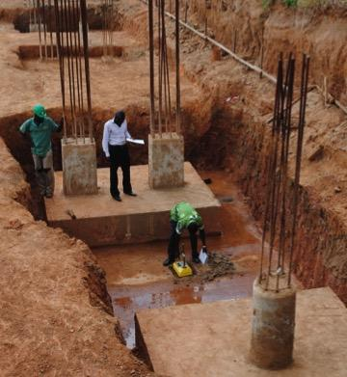
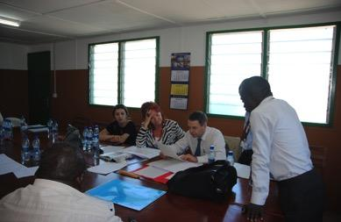
Quality Products
When all is said and done, reliability is the measurement by which any supplier should be judged. Over the years, Consilium has earned the reputation of providing high-performing, rock-solid solutions.
Environment
Consilium recognizes that in society today environmental issues are of concern to its customers, suppliers, employees and the community as a whole and constantly works in partnership with them, industry and regulatory authorities to improve quality of life in general.
We maintain a proactive environmental management system in accordance with the provisions of BS EN ISO 14001
Fiscal Independence
Consilium believes in financing our growth through our own earnings and we have consistently done so. Our flat infrastructure, low overhead, and diversity of products give us the ability to weather economic cycles and turn them in our favor. With a history of financial stability, you can count on Consilium to be around for many years to come.

Slide 4
Our Directors
Managing Director
Gabriel Addai – B.Sc. Building Technology, MSc Constr Management, MRICS, PRINCE2, MCIOB, MAACE,
Skills: Project Management, Contract Administration and management, Construction management,
Property development and management, Quantity Surveying, Building design and construction.
Mr Addai is a PRINCE 2® graduate Professional with a BSc. Degree in Building Technology and a MSc. Degree in Project Management both degrees from KNUST. He went through rigorous training programmes with the projects and contracts departments of AngloGold Ashanti Limited, Ghana from 1997- 2001 as Projects estimator, Quantity Surveyor and Site Engineer. He joined Fridoug Limited in 2001 as a projects engineer and rose to Senior Quantity Surveyor and Operations Manager where he was responsible for the construction of several projects, running simultaneously, with a combined contract value of over 40million Dollars.
He then went to London where he worked for Dean and Dyball (a quantity surveying firm) as a quantity surveyor for a refurbishment project in London, Morrison Contractors as a quantity surveyor on the Thames water project in Milton K and also worked for Muchelparkman Plc. in London as a Project Manager where he managed a team of 15 quantity surveyors and quantity surveying assistants in re-measurement and closing of contracts awarded and executed on behalf of TFL (transport for London). Total contract sums ran in excess of 60Million Pounds.
He then went back to AngloGold Ashanti Ghana Limited where I led a team of quantity surveyors to conduct Mine Closure Liability Estimates as part of the requirements to meet the ISO9001 certification standards (2007-2008). After the project with AngloGold he joined Dream Homes and Construction Limited as a Director of Operations where he coordinated the construction of 72 affordable housing units and 15 executive houses within a year. He was the lead PM for SG-SSB Bank where he coordinated a team of consultants and 12 contractors in the Procurement and construction of a 20million USD ultramodern head office complex and also managed the implementation of a new working environment, where the existing working spaces and methodologies were analysed and reviewed to conform to Global SG standards. He was also the lead project manager for Standard Chartered Bank where he managed the delivery of 15 Branches, several churns and also the Procurement, financing and construction of a new Head Office building at an estimated cost of $60million.
He is the founding member of Consilium Limited and has been the Managing director of the company bringing in his huge expertise in construction and development.

Slide 5
Our Directors
Director- Projects and Facilities Management
Dickson Segbefia– EMBA Project Management, BSc Administration, H.N.D Estate Management
Skills: Project and contract management, Facilities Management, Project and investment appraisal and
Value Engineering.
Mr Segbefia has been a valuable asset to Consilium, since joining in 2014. He brings on board immeasurable expertise from over 20 years in the construction industry having worked with institutions like Regimanuel Gray Limited as General Manager , Fidelity Bank as Facilities Manager, Standard Chartered Bank as Head of Facilities Management West Africa and Ericson as regional Facilities Manger for Africa. He has vast experience in Facilities management, Project Development and Real Estate Portfolio management.
Director- Legal & Administration
Mame Esi Kyeremeh – LLM International Law, MA Applied Communication, BA
Skills: Law, Human Resources Management, Internal & External Communication, Arbitration and Mediation
Ms. Kyeremeh is a experienced Legal Practitioner with experience in mediation, community service advisory, public relations and communications management.
She has worked with Coventry University in Coventry UK as Corporate Communication Executive and the Leicester Community Advice and Law Service Centre as a Legal Executive. She joined Consilium in 2016 as Head Legal and Administration and has been of invaluable service to the company.

Slide 6
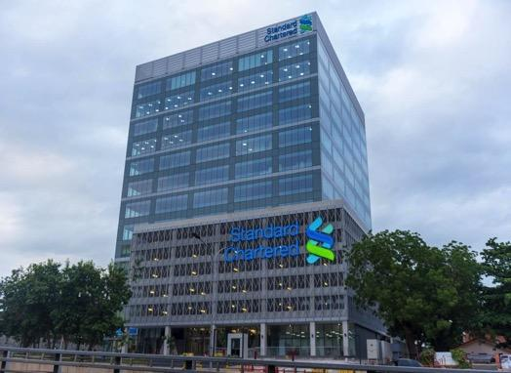
Our Expertise - Commercial Buildings
Project Management Services for the Construction of New Head Office for Societe Generale Bank Ghana
Project Management services for the construction of New Head Office Building for Standard Chartered Bank Ghana

Slide 7
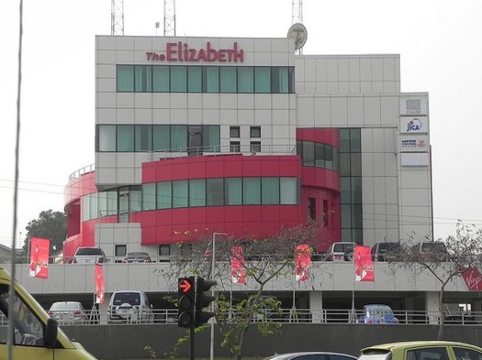
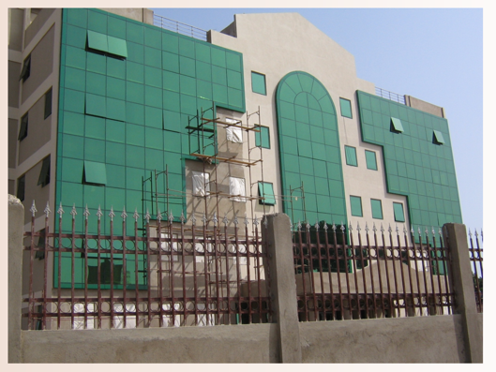
Our Expertise - Commercial Buildings
Project Management Services for the Construction of Office complex (the Elizabeth) in Accra
Project Management services for the construction Office building for GCCSFA in Accra

Slide 8
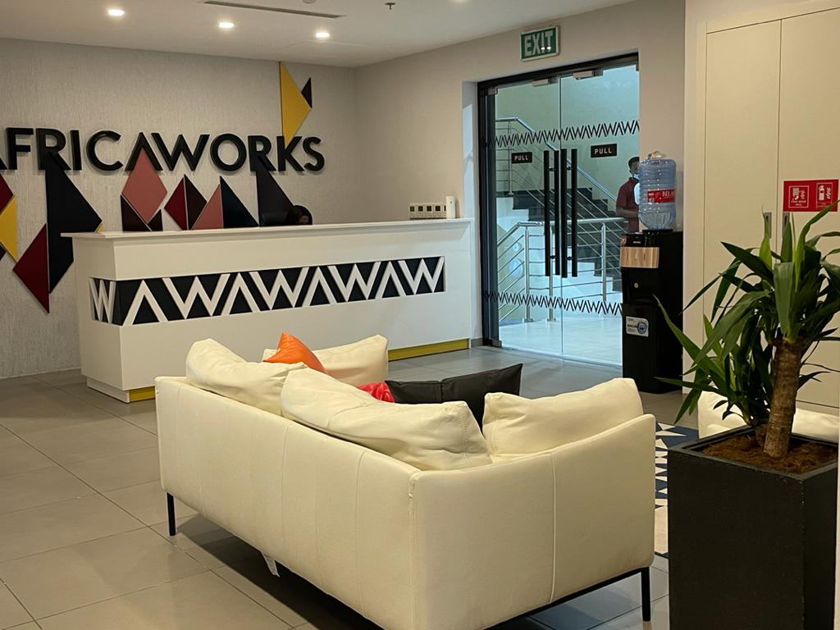
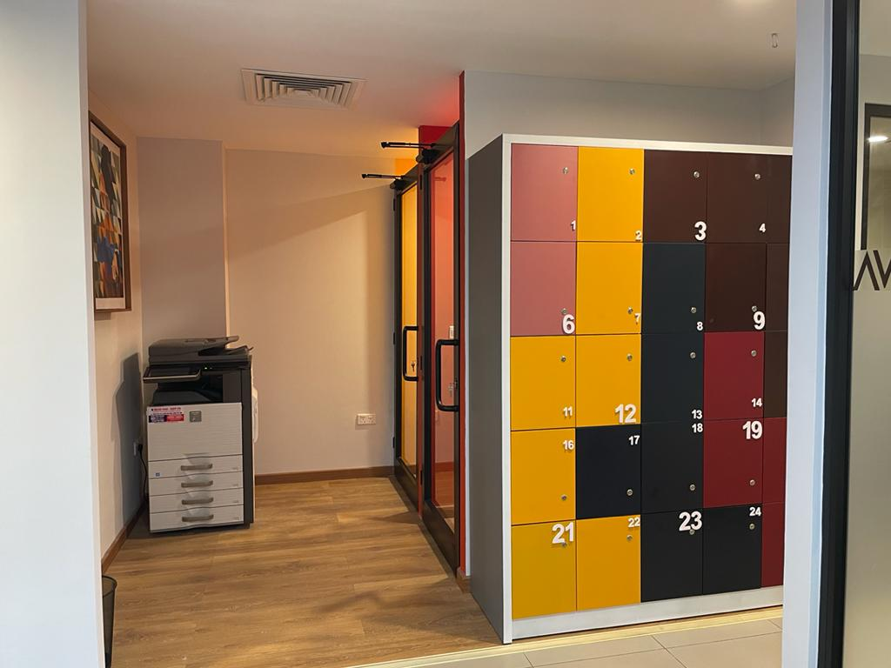
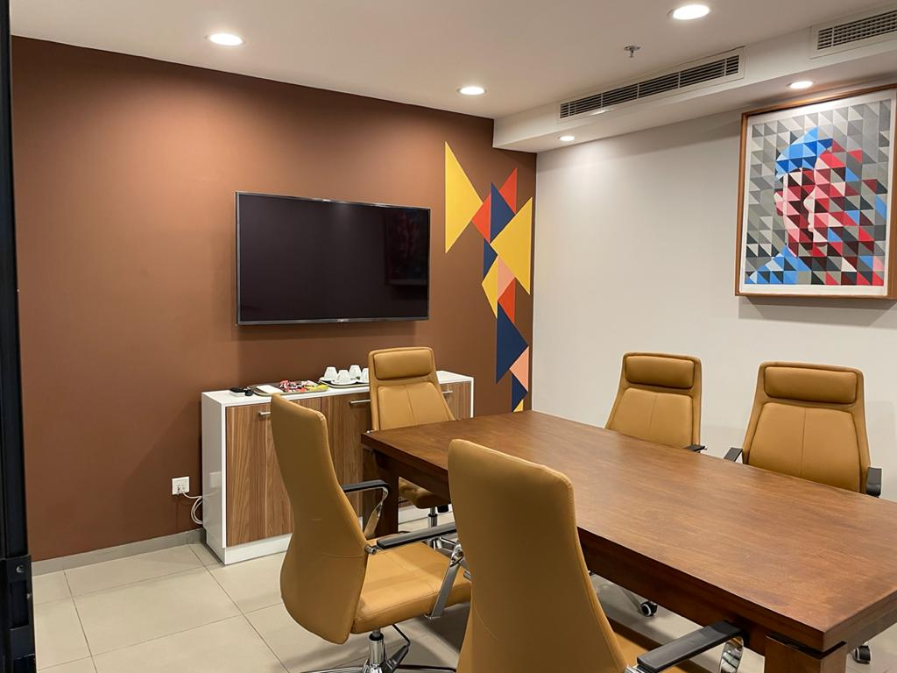
Our Expertise - Commercial Buildings
Fit Out Works
Client: AfricaWorks Ghana (Volta Place)
Description of works: Fit out works comprising dry wall partitioning, floor and ceiling works, carpet
Installation, furniture installation, blinds and Furniture supply/installation

Slide 9
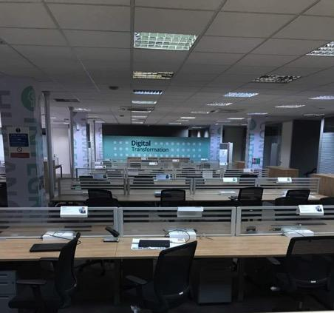
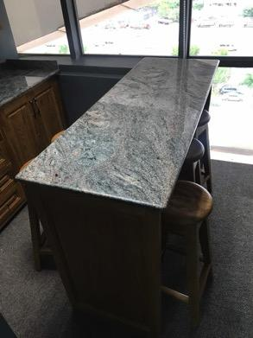
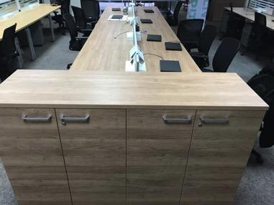
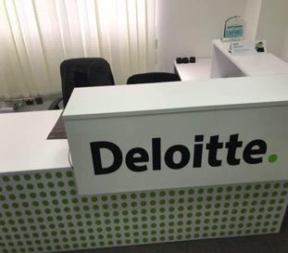
Our Expertise - Commercial Buildings
Fit Out Works
Client: Deloitte Ghana
Description of works: Fit out works comprising dry wall partitioning, floor and ceiling works, carpet
Installation, furniture installation, blinds and associated civil and joinery works

Slide 10
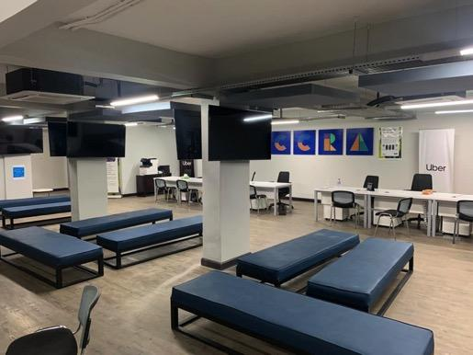
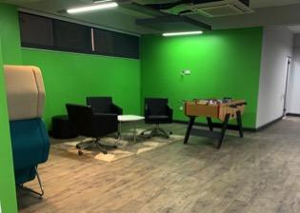
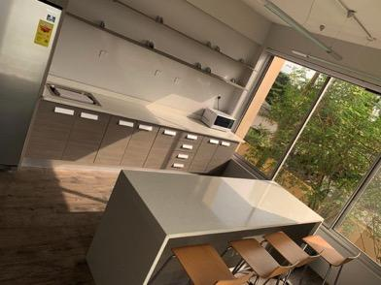
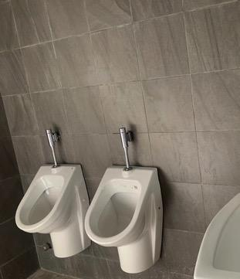
Our Expertise - Commercial (Uber Ghana)
New Office for Uber Ghana Limited

Slide 11
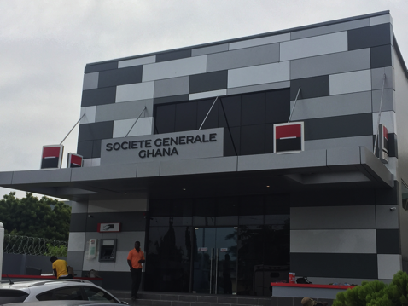
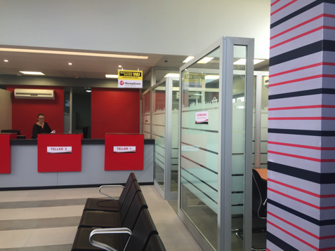
Our Expertise - Commercial (Societe Generale)
Construction of New East Legon Branch
Client: Societe Generale Bank Ghana
Duration: 16 Weeks
Description of works: Works comprised the construction and complete fit out of a building
To serve as banking hall for SG bank at east legon. Major work items include curtain walling,
Tiling, paving works, glazing, installation of counter tops and furniture etc.

Slide 12
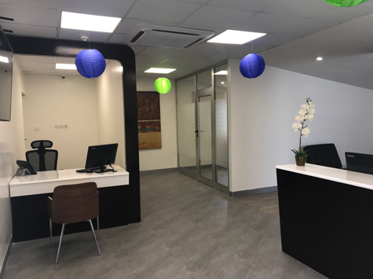
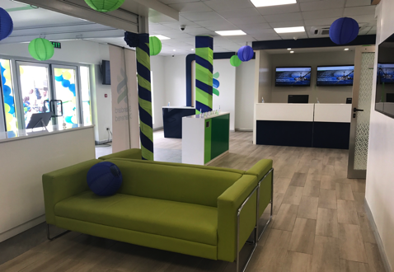
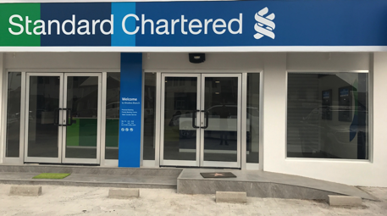
Our Expertise - Commercial (Standard Chartered)
Construction of New Banking hall will associated finishes and furniture at Ahodwo Kumasi for Standard Chartered Bank

Slide 13
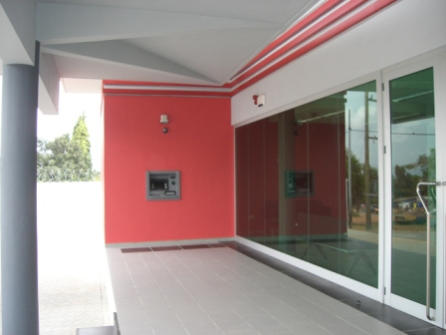
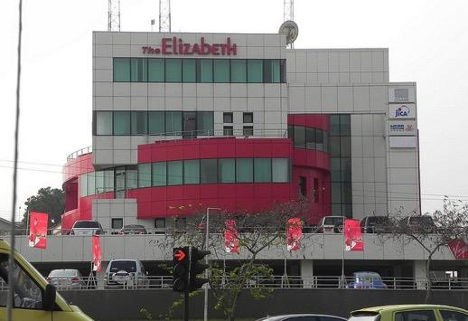
Our Expertise - Commercial Buildings
End to end project Management for the Construction of New Branch for Societe Generale Bank Ghana at Madina in Accra
Project Management services for the construction of Multi Purpose Commercial building (The Elizabeth in Accra)

Slide 14
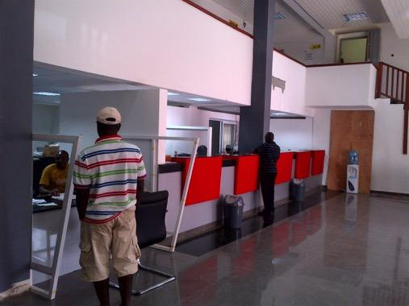
Refurbishment of Societe Generale Bank – Adum Branch
Upgrading of Dealing Room to world Class Standard Dealing room for Local Bank in Ghana

Slide 15
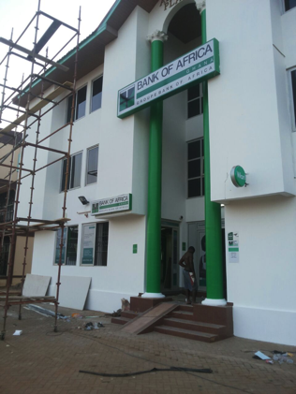
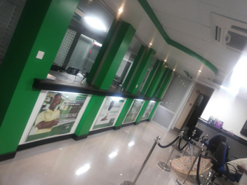
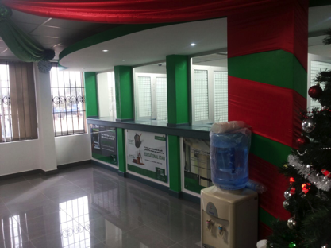
Development of Ashiman Branch
Client: Bank of Africa Ghana
Duration: 7 Weeks
Description of works: Works comprised the complete fit out of an existing building to construct teller
Cages, partitions for officers, tiling, ceiling, glazing and electrical works. Project was achieved within
Budget and time lines.

Slide 16
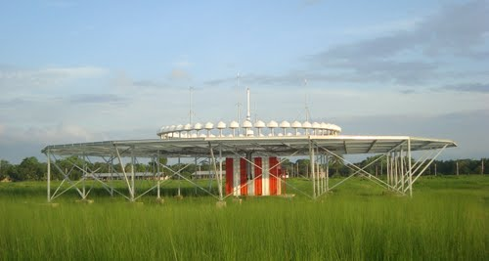
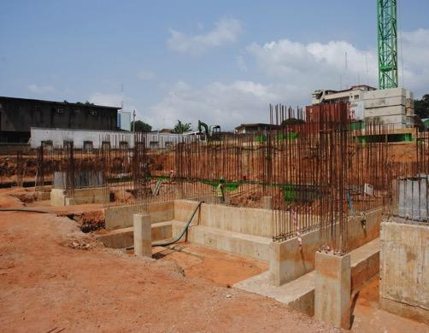
Our Expertise – Civil Engineering Works
DME (distance Measuring Equipment Installation) for the Ghana Civil Aviation Authority (Civil works for Thales Group)
Construction of Reinforced Concrete Bases for Tank farm

Slide 17
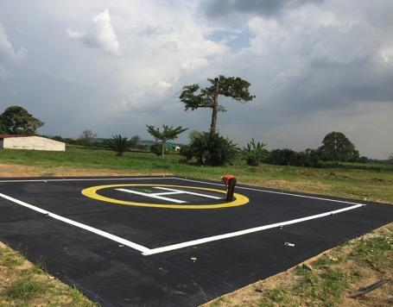
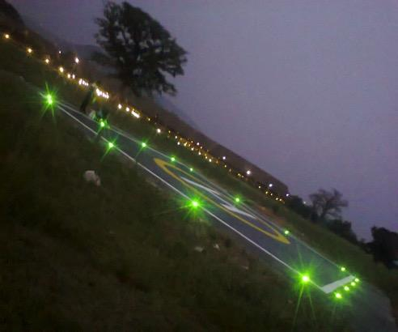
Construction of Helipad and associated works
Client: The royal Senchi Hotel
Description of works: Works comprised earthworks and soil stabilization, base and sub base materials, Concrete works, installation of aviation lights and fire fighting equipment as well as emergency rescue equipment

Slide 18
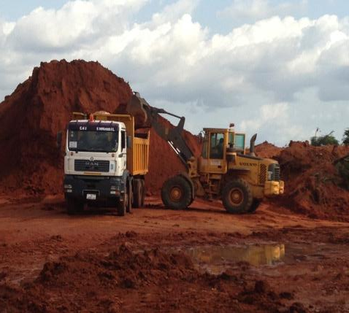
Civil Works and Installation of Instrument Landing Systems at Kumasi Airport
Client: Ghana Civil Aviation Authority
Duration: 8 weeks
Description of Works: Works comprised the placing and compaction of approx125,000 cu m of imported
Fill material to make up levels for glide slope, installation of 75m antenna for glide equipment and concrete works
And installation of 21element localizer elevated at 12m using frangible pipes.

Slide 19
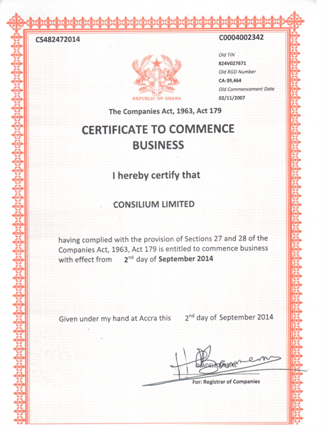
Certificates

Slide 20
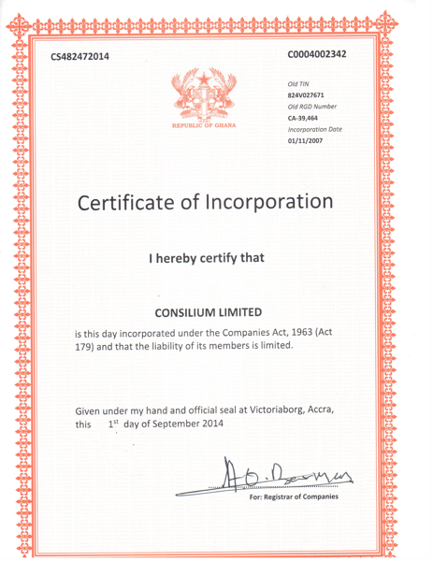
Certificates

Slide 21
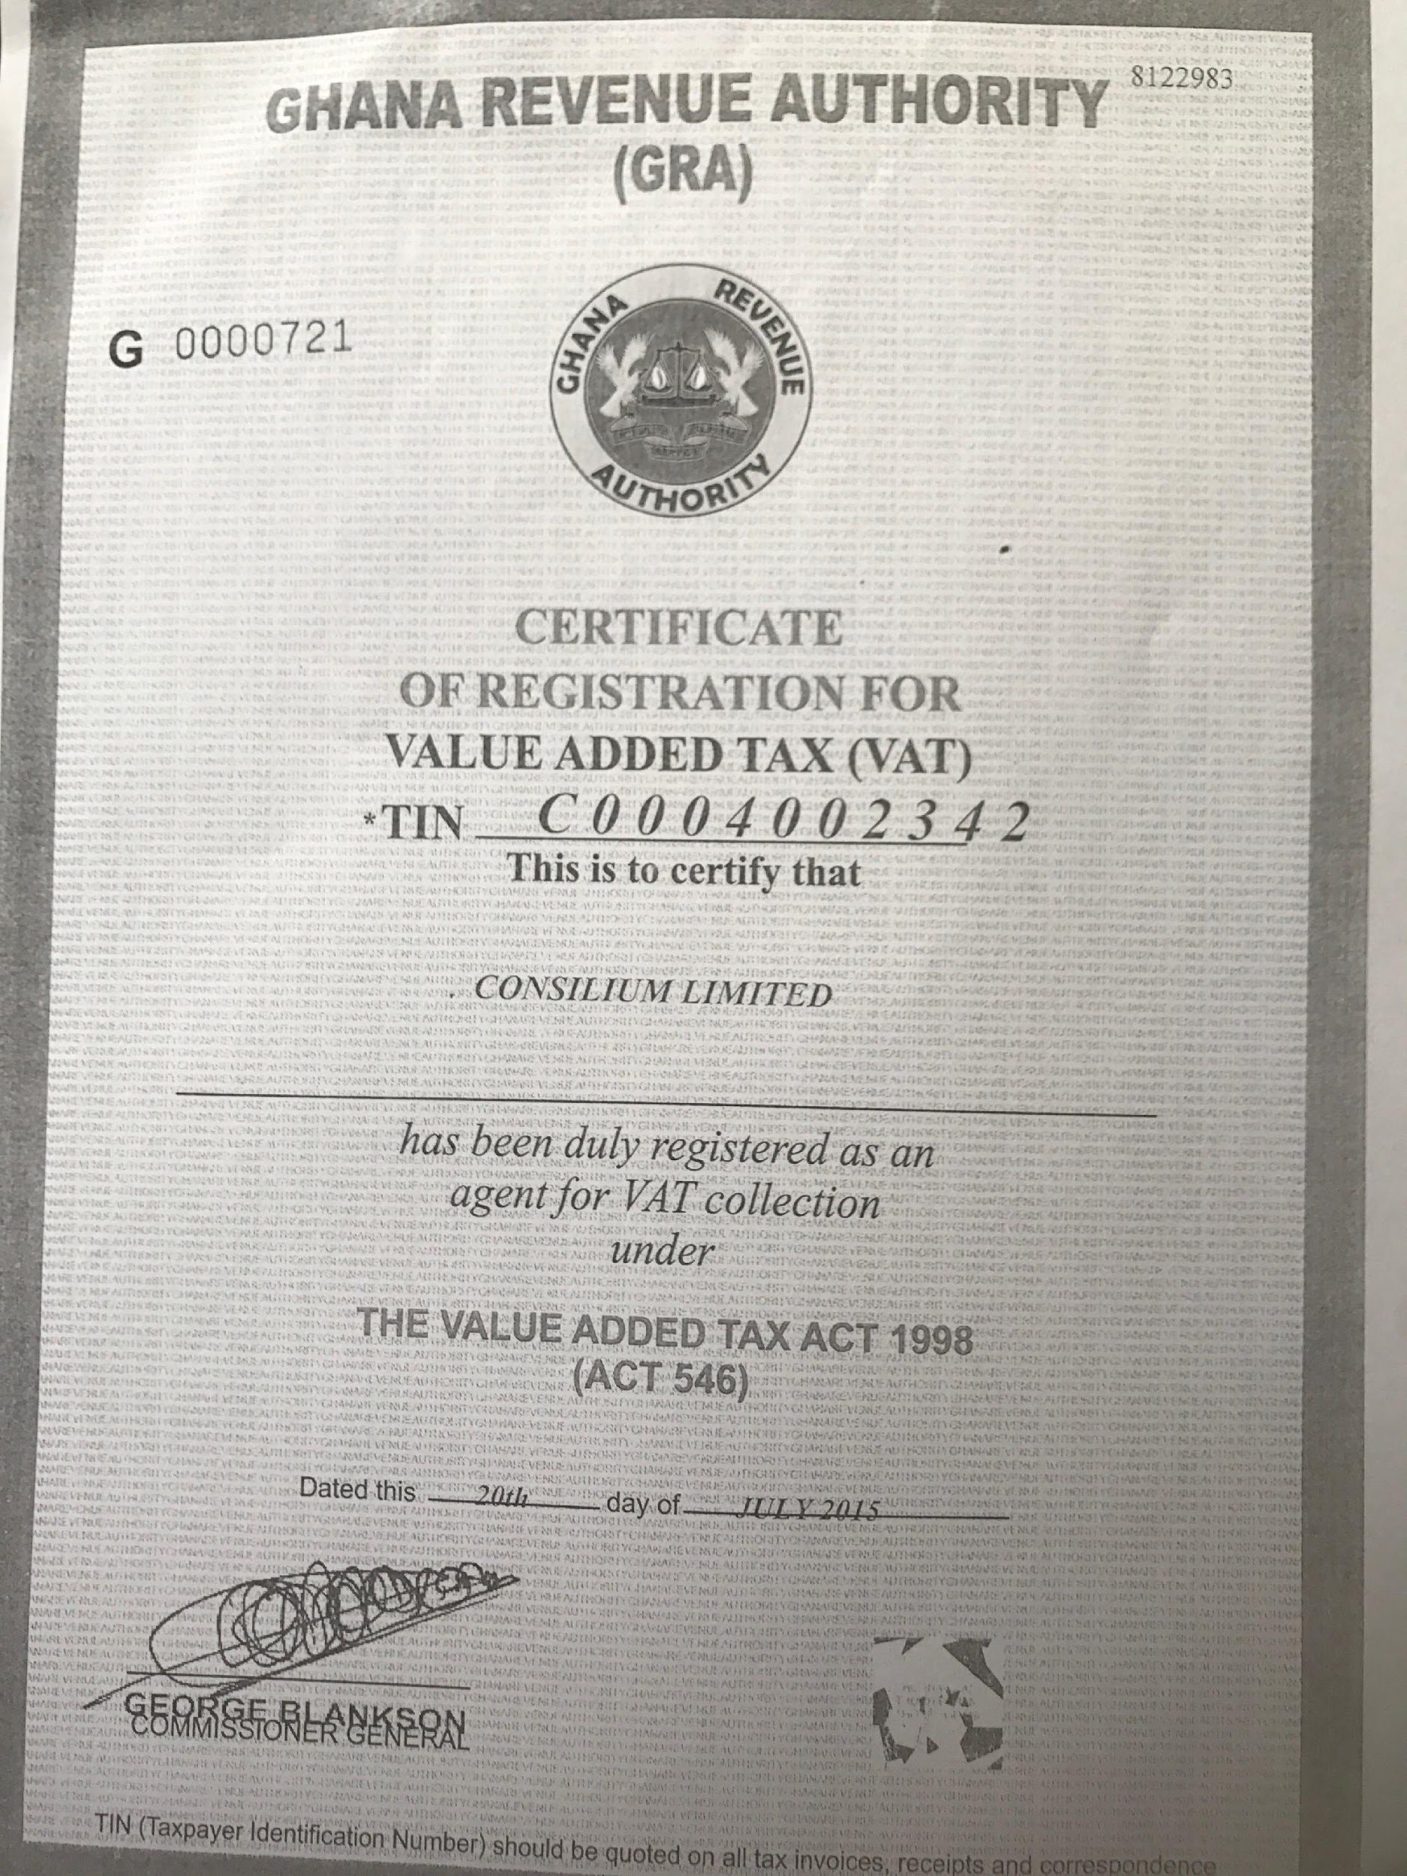
Certificates

